Slide 1



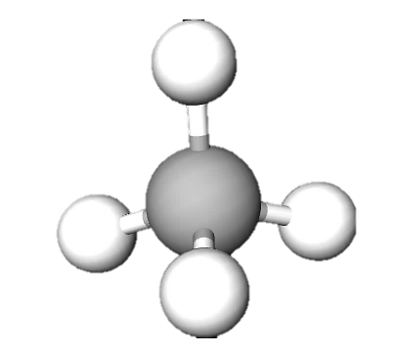
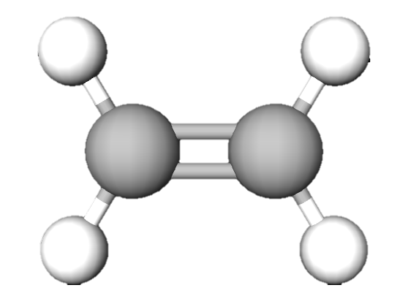
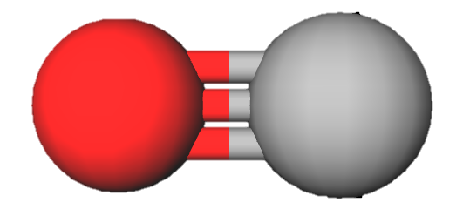
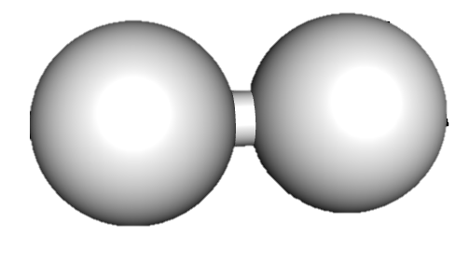
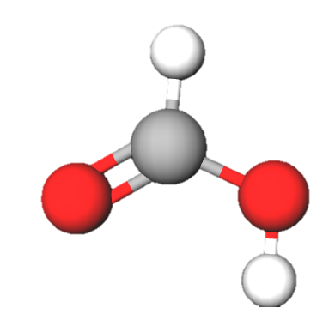
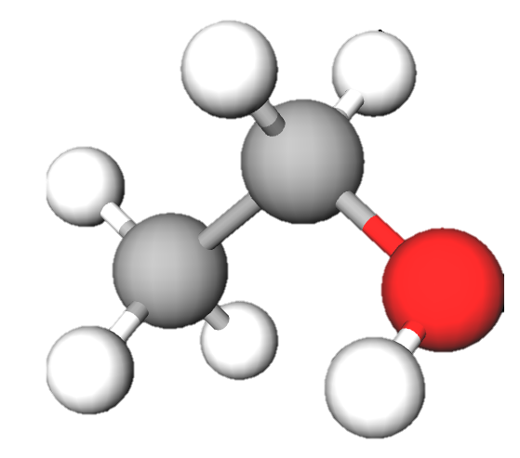
CO₂ hunters!
Join the fight for the energy transition!
Split into teams.
You have 10 minutes to convert CO₂.
The team with the best products wins!
Scores
+1
+2
carbon monoxide
1 C, 1O
hydrogen
2H
+7
methane
1 C, 4 H
+3
ethylene
2 C, 4 H
+4
+6
formic acid
1 C, 2 H, 2O
ethanol
2 C, 6 H, 1O
Bonus: +10 if you use the most C.
+5 if you use the most H.

